Slide 2
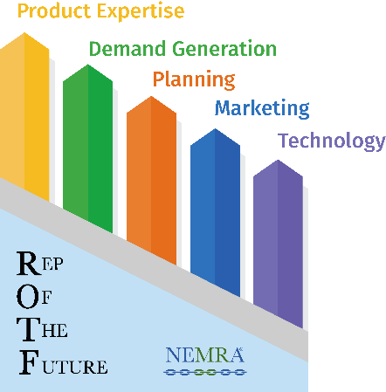
The Five Pillars
Product expertise
Investment in specialists
Obtaining certifications (ex. CPMR, LC, LEED AP, RCDD)
Training plan
Internal training process
Increase utilization of NEMRA University tool
Maximizing factory training resources
Factory visits

Slide 3
The Five Pillars
Demand Generation
The key to survival is more focus on the end user / influencer (ex. engineers, architects)
Market segment specialists
Ability to adapt to market conditions
Complimentary product basket to maximize demand impact
Positioning new products quickly

Slide 4
The Five Pillars
Planning
Annual agency plan and account planning
Product line direction and synergy
Investigating emerging markets and technologies
Succession plan focus-business continuity
Reinvestment strategy / roadmap
Non-traditional shift in revenue generation
Marketing
Sales Operations
Training

Slide 5
The Five Pillars
Marketing
Adaptation critically important in a post-COVID world
Dedicated resources & investment in a digital marketing platform
Alignment with sales operations & leadership
Elevating brand image & awareness
Market segmentation & lead generation
Product positioning & outreach

Slide 6
The Five Pillars
Technology
Investment in CRM, marketing automation, ERP system, data analytics, virtual interaction tools
Utilization of available technologies to enhance sales enablement
Dedicated personnel and processes

